Slide 1


Korea University
MACHINE LEARNING
Customer Churn Prediction in Subscription-Based Telecom Services
Presented by : Team 1
Arij Faiha
Huyngim Eng
Jessica Novita
Shi Xiao Yu
Notes:
prediction need to use Y at time t+h and X at time T (Prediction Horizon) and

Slide 2
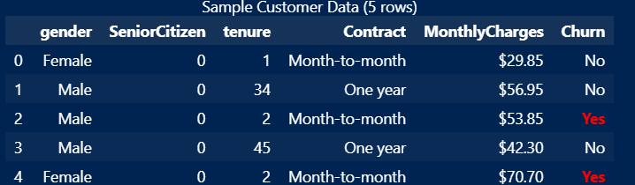
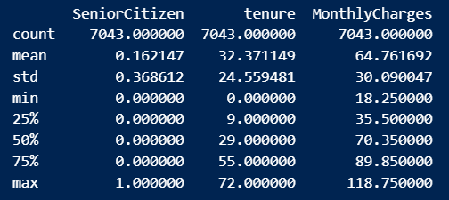

Korea University
DATA RECAP
Dataset: IBM Telco Customer Churn
7043 customers, ~21 features (20 variables)
Target: Churn (Yes/No)
Goal: Predict customer churn
1
Raw Data
2
Pre-Processing
3
EDA
4
Data Split
5
Model Evaluation

Slide 3


CURRENT MILESTONE
Completed EDA, feature encoding (45 features), train/val/test split (80/10/10), and identified 3 key churn drivers: contract type, tenure, and monthly charges.
Successfully completed the modeling phase of the project.
All planned classification models have been trained, tuned, and evaluated on the Telco Customer Churn dataset.
Evaluated 7 classification models including boosting methods (AdaBoost, GBM, XGBoost, LightGBM)
Logistic Regression selected as final model. Tied AUC (0.85) with Random Forest but higher churn recall (81% vs 75%), and superior interpretability.

Slide 4


WHAT CHANGED..
Applied Stratify in train/val/test split to preserve churn ratio across all sets
Added Pipeline (StandardScaler → model) to prevent data leakage during scaling
Dropped one column (TotalCharges) that highly correlated with MonthlyCharge x Tenure to avoid multicollinearity issue.
No major changes to the overall direction.
Churn prediction via supervised classification remains the core objective

Slide 5

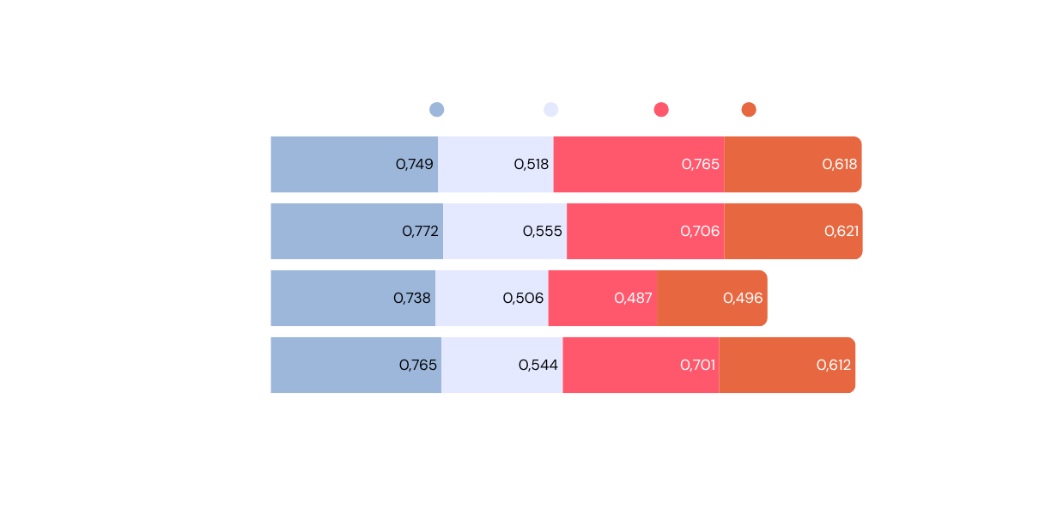
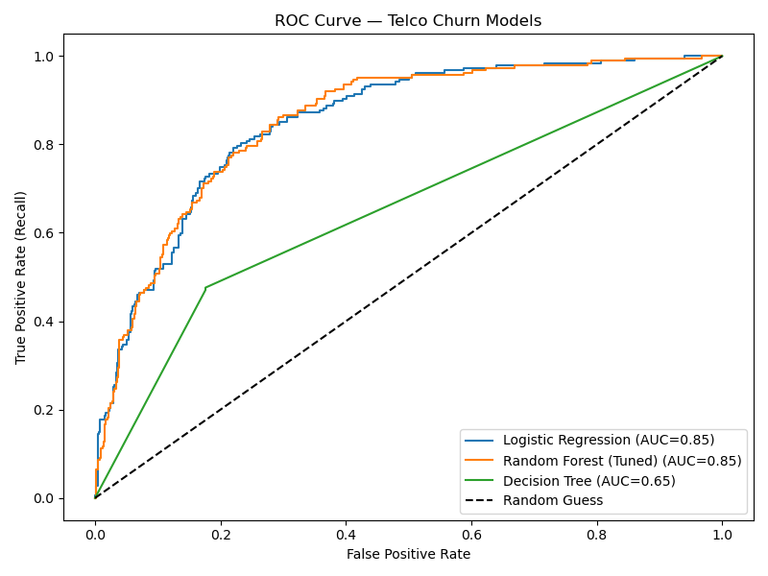

KEY FINDING
Churn level class
Logistic Regression Provides the Best Balance of Performance and Interpretability
LR and RF perform similarly well, while Decision Tree underperforms.
Prioritize Recall over Accuracy due to class imbalance (26.5% churn)

Slide 6
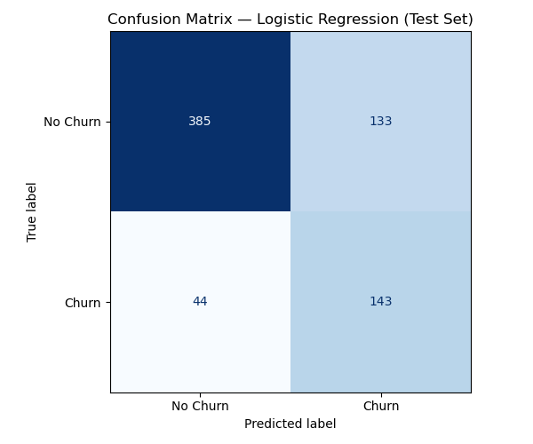
-LOGISTIC REGRESSION-
CONFUSION MATRIX
TN (True Negative) = 385
→ Correctly predicted non-churn customers
FP (False Positive) = 133
→ Non-churn customers flagged as churn
FN (False Negative) = 44
→ Churn customers missed by the model
TP (True Positive) = 143
→ Correctly identified churn customers
Effective for churn detection, with moderate false alarms

Slide 7
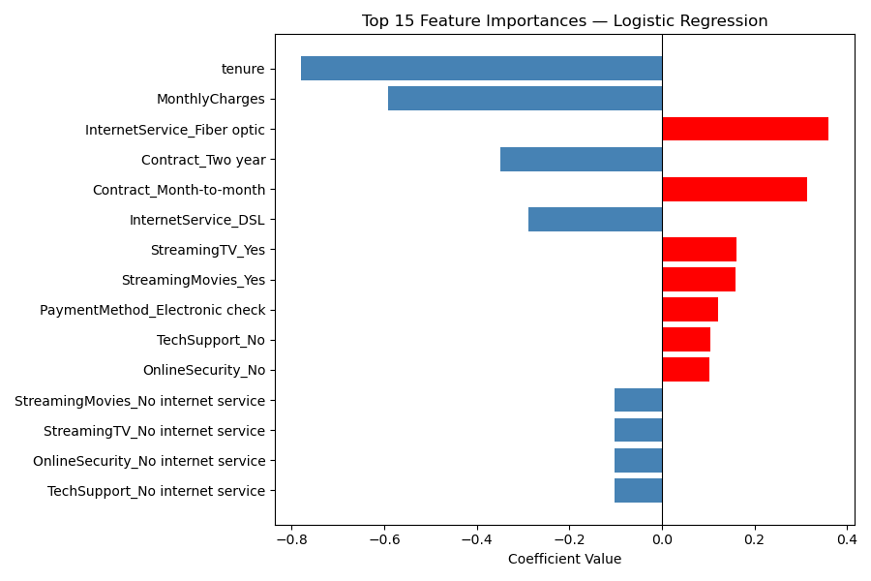
-LOGISTIC REGRESSION-
FEATURE IMPORTANCE
Red Bars (positive coefficients) :Increase Churn
Month-to-month contracts 🚨
High monthly charges
No tech support
New customers
Blue Bars (negative coefficients) : Decrease Churn
Long-term contracts ✓
Tech support services
Lower pricing
Loyal long-tenure customers
Contract Type is the key churn driver

Slide 8

PENDING TASKS
Final test set evaluation
Comparative feature importance across other models
Business insights & recommendations
Incorporate to the final report

Slide 9
Korea University
AI USAGE STATEMENT
This project utilized AI as a supporting tool during the exploratory data analysis phase.
All data analysis, interpretation of results, business insights, and final decisions were performed independently by the team. All AI-generated suggestions were reviewed, verified, and adapted before use.
AI Tool:
Perplexity AI (Sonnet 4.6)
M365 Copilot AI (Smart Function)
GPT-5.4 Thinking

Slide 10

Korea University
THANK YOU!

Slide 11
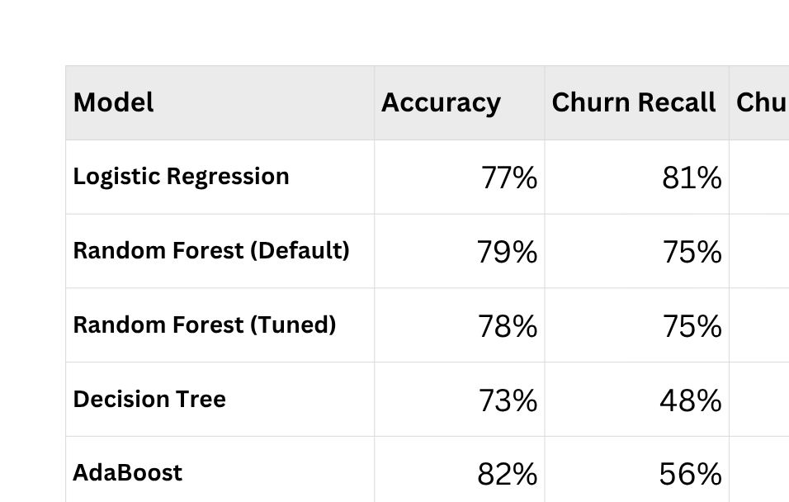
APPENDIX
Comparison of all classification models tested

